Slide 1
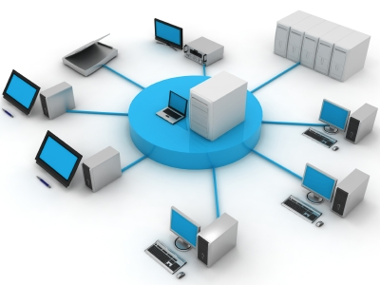

Acacia Ridge Presbyterian Church Network Architecture

Slide 2
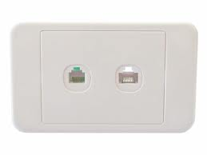
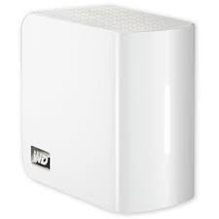
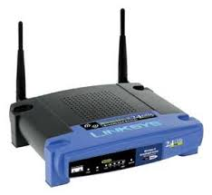
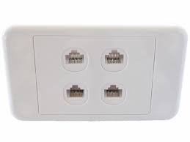
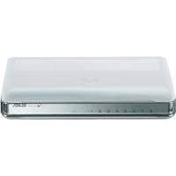
Physical Network ports in ARPC Top hall
D6
D4
D3
Office
Office
Office
D5
Office
Kitchen
Store
D7
D2
Patch Panel
for D1-7 and link to crèche room
D1

Slide 3
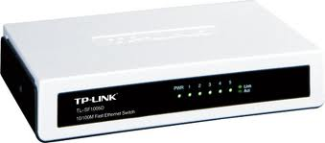
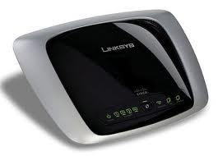
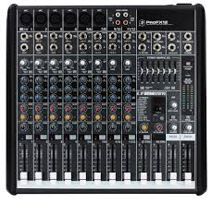
Physical Network ports in ARPC Main Auditorium
Mum’s Room
Crèche Room
Main Auditorium
Kitchen
Cry Room

Slide 4


ARPC Logical Network Diagram
ADSL
ARPC Wireless
192.168.1.x
Linksys WAG160N Router (192.168.1.1)
DHCP Range 192.168.1.20-?
TPLink TLSF1005D Switch
ASUS GX10088 Switch
ARPC2 Wireless
Western Digital NAS
DHCP enabled?
Linksys WRT54Gv3.1
192.168.1.x
Routing Disabled?
Notes:
Usual IP Addresses:
Office PC (Jenny) = 192.168.1.43
Konica Minolta Photocopier = 192.168.1.20
Weber’s NAS=192.168.1.40
WAG160N=192.168.1.1
WRT54GV3.1=192.168.1.2
Sounddesk PC=192.168.1.?
Dan=192.168.1.?
Ros=192.168.1.?
Weber=192.168.1.?

